Slide 1
Web Development
Module 2, Lesson 6:
Working with Node.js and Azure Table Storage

Slide 2
Topics
Types of Storage
Azure Table Storage
Azure and Node.js

Slide 3
Objectives
By the end of this lesson you should be able to:
Understand the basics of Azure Storage
Interact with Azure Storage Tables using Node.js
Perform basic CRUD operations

Slide 4
Microsoft Azure Storage
All access to Azure Storage is done through a storage account
Azure Storage
Concepts
Container
Blobs
Table
Entities
Account
Queue
Messages
Share
Directories/Files
Notes:
Notes:
Azure offers many storage options for different purposes
Containers better suited for binary data
Share for files
Queue for messages
Tables for structured entities (noSQL)
References:
https://azure.microsoft.com/en-us/documentation/articles/storage-introduction/

Slide 5
Types of Storage
Storage | Description
Blob (Object) | Stores unstructured object data Can be any type of text or binary data, such as a document, media file, or application installer
Table | Stores structured datasets Table storage is a NoSQL key-attribute data store
Queue | Provides reliable messaging for workflow processing and for communication between components of cloud services
File | Shared storage for legacy applications using the standard SMB protocol
Notes:
Notes:
Table Storage – NoSQL key attributed data store allows for rapid development and fast access to large quantities of data.
File Storage:
Azure virtual machines and cloud services can share file data across application components via mounted shares
On-premises applications can access file data in a share via the File service REST API.

Slide 6
Azure Table Storage
Storage
Account
Table
Entity
Name = …
Email = …
Customers
Sally
Name = …
Email = …
winephotos
Directories/Files
Notes:
References:
https://azure.microsoft.com/en-us/documentation/articles/storage-nodejs-how-to-use-table-storage/

Slide 7
Why NoSQL?
CAP Theorem: A+P
BASE
No (or almost no) relationships in the database
Scalable, distributed, maintainable
Notes:
Notes:
CAP Theorem: You can have 2 our of 3 (Consistency, availability and partition).
RDBMS is CA and NoSQL is AP
RDBMS encounter architectural challenges to overcome some combination of performance bottlenecks, scalability, operational complexity, and increasing administration and support costs.
BASE (Basic availability, soft state and eventual consistency) over ACID (Atomic, Consistent, isolated, durable)
References:
http://neo4j.com/blog/acid-vs-base-consistency-models-explained/
https://aws.amazon.com/nosql/

Slide 8
Other Major Hosted NoSQL Alternatives
MongoDB: Compose, mLab
AWS DynamoDB and SimpleDB
IBM Cloudant
Notes:
References:
https://www.compose.io/mongodb/
https://mlab.com/
http://aws.amazon.com/dynamodb/
http://aws.amazon.com/simpledb/
https://cloudant.com/

Slide 9
Table Usage
Tables are used for:
Storing TBs of structured data capable of serving web-scale applications
Storing datasets that don't require complex joins, foreign keys, or stored procedures and can be denormalized for fast access
Quickly querying data using a clustered index
Accessing data using the OData protocol and LINQ queries with WCF Data Service .NET Libraries
Notes:
Notes:
The Table service can be used to store and query huge sets of structured, non-relational data, and tables will scale as demand increases.

Slide 10
Tables, Entities, Properties, and Keys
Storage | Description | Size
Tables | A table is a collection of entities. | Only limited by account capacity
Entities | An entity is a set of properties, similar to a database row. | Up to 1 MB
Properties | A property is a name-value pair. | Up to 252 per entity
Partition Keys | Part of a unique identifier for the entity. Must be a string value. | --
Row Keys | Unique entity identifier within the partition. Must be a string value. | --
Notes:
Notes:
Tables:
Tables don't enforce a schema on entities, which means a single table can contain entities that have different sets of properties.
Entities
An entity is a set of properties, similar to a database row.
An entity can be up to 1MB in size.
Each entity can include up to 252 properties to store data.
Each entity also has 3 system properties that specify a partition key, a row key, and a timestamp.
Entities with the same partition key can be queried more quickly, and inserted/updated in atomic operations.
An entity's row key is its unique identifier within a partition.
Partition Key
Entity within the same partition can be queried more quickly. For example, posts on JavaScript and posts on Java can have partition keys "javascript" and "java" respectively.
Row Key
For example, 001, 002, 003.

Slide 11
Common Endpoints
Retrieve a list of tickets
Retrieve a specific ticket
Create a new ticket
Update ticket #12
Delete ticket #12
Partially update ticket #12
What can I do to ticket #12?
What headers would I get if I tried to get ticket #12?
GET /tickets
GET /tickets/12
POST /tickets
PUT /tickets/12
DELETE /tickets/12
PATCH /tickets/12
OPTIONS /tickets/12
HEAD /tickets/12
Notes:
Notes:
We will interact with the tickets entities via these endpoints (as an example)

Slide 12
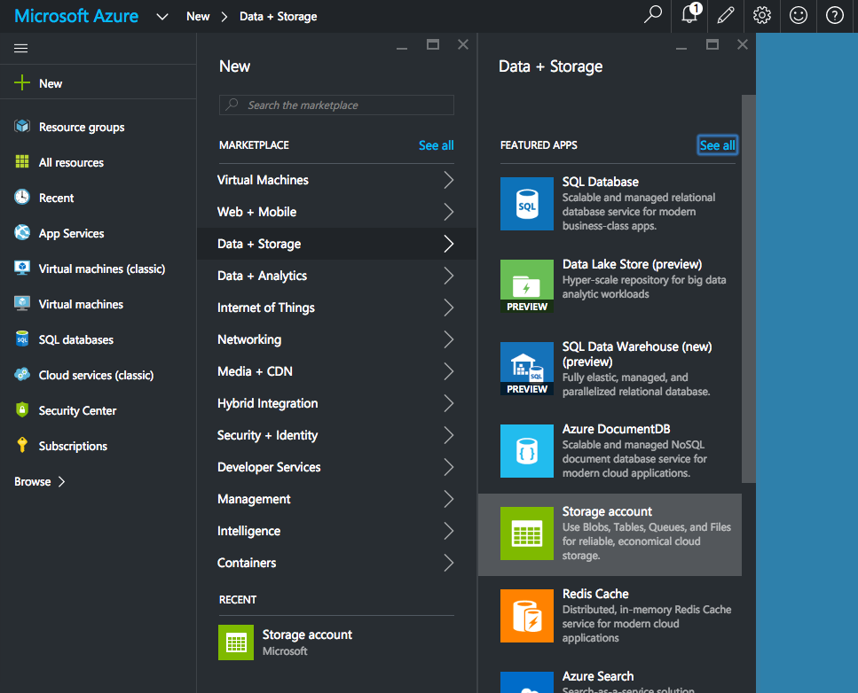
Creating an Azure Storage Account
Notes:
Notes:
Sign up for Azure to access portal.azure.com
Select a subscription, e.g., free trial, pay-as-you-go, etc.
Select New -> Data + Storage -> Storage account to create a new storage account
Configure the settings

Slide 13
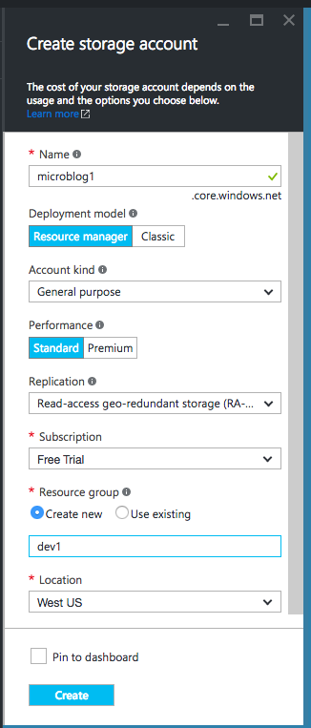
Storage Settings
Name: unique name for your storage (microblog1 in this example)
Deployment model: Resource manager
Account kind: General purpose
Performance: Standard
Replication: RA-GRS
Subscription: Free Trial
Resource group: New
Location: West US
Pin to Dashboard
Notes:
Notes:
These are recommended settings for the course projects.
References:
https://azure.microsoft.com/en-us/documentation/articles/storage-premium-storage/
https://azure.microsoft.com/en-us/documentation/articles/resource-group-portal/
https://azure.microsoft.com/en-us/documentation/articles/storage-redundancy/

Slide 14
Accessing Storage Programmatically
To access storage with Node.js remotely, we'll need:
Name
Key
Notes:
Notes:
Name will be a part of the URL endpoint as well

Slide 15
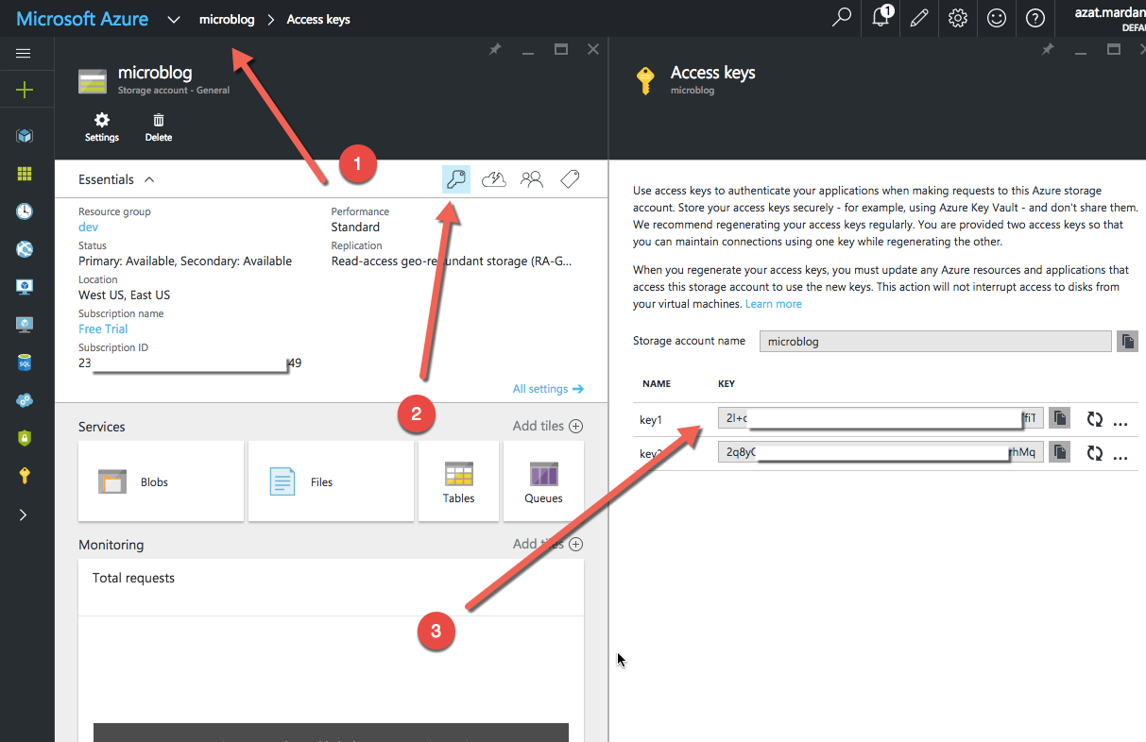
Storage Access Key

Slide 16
Passing Keys to Node.js
Add to .gitignore:
start.sh
Create start.sh:
AZURE_STORAGE_ACCOUNT=name AZURE_STORAGE_ACCESS_KEY=key node express.js
Run express.js with sh start.sh
Notes:
Notes:
Students can substitute name and key for their own values.
This shell script will launch express.js.
Students can use a different name for their files.
Remember, there's no spaces before "=" and after, and no new line symbols (just one line).

Slide 17
Azure and Node.js
Terminal:
Node.js:
$ npm install azure-storage@1.0.1
var azure = require('azure-storage');
Notes:
Notes:
This course works with v1.0.1, later or earlier versions are not guaranteed to work as described.
References:
https://azure.microsoft.com/en-us/documentation/articles/storage-nodejs-how-to-use-table-storage/

Slide 18
Name and Key
AZURE_STORAGE_ACCOUNT and AZURE_STORAGE_ACCESS_KEY must be set in the environment variables (process.env)
Starting with start.sh as described earlier, these values will be populated

Slide 19
Creating the Connection and a Table
Creating Connection
Creating a Table
var tableSvc = azure.createTableService();
tableSvc.createTableIfNotExists('mytable', function(error, result, response){
if(!error){
// Table exists or created
}
});
Notes:
Notes:
The result.created will be true if a new table is created, and false if the table already exists.
The response will contain information about the request.

Slide 20
Retry Filters and Allying Filters
Two filters that implement retry logic are included with the Azure SDK for Node.js
ExponentialRetryPolicyFilter
LinearRetryPolicyFilter
Allying Filters:
var retryOperations = new azure.ExponentialRetryPolicyFilter();
var tableSvc = azure
.createTableService()
.withFilter(retryOperations);

Slide 21
Creating an Entity
var task = {
PartitionKey: {'_':'hometasks'},
RowKey: {'_': '1'},
description: {'_':'take out the trash'},
dueDate: {'_':new Date(2015, 6, 20), '$':'Edm.DateTime'}
};
Notes:
Notes:
There is also a Timestamp field for each record, which is set by Azure when an entity is inserted or updated.
Alternatively, helper function entityGenerator can be used.

Slide 22
Creating an Entity (Continued)
var entGen = azure.TableUtilities.entityGenerator;
var task = {
PartitionKey: entGen.String('hometasks'),
RowKey: entGen.String('1'),
description: entGen.String('take out the trash'),
dueDate: entGen.DateTime(new Date(Date.UTC(2015, 6, 20))),
};
Notes:
Notes:
There is also a Timestamp field for each record, which is set by Azure when an entity is inserted or updated.
Alternatively, helper function entityGenerator can be used.

Slide 23
Inserting an Entity
//Insert Only:
tableSvc.insertEntity('mytable',
task, // entity
function (error, result, response) {
if(!error){
// Entity inserted
}
}
);
Notes:
Notes:
Insert only:
If the operation is successful, result will contain the ETag of the inserted record and response will contain information about the operation
```js
tableSvc.insertEntity('mytable',
task,
{echoContent: true},
function (error, result, response) {
if(!error){
// Entity inserted
}
}
);
```
By default, insertEntity does not return the inserted entity as part of the response information. If you plan on performing other operations on this entity, or wish to cache the information, it can be useful to have it returned as part of the result. You can do this by enabling echoContent

Slide 24
Inserting an Entity (contiued)
//Insert and Return:
tableSvc.insertEntity('mytable',
task,
{echoContent: true},
function (error, result, response) {
if(!error){
// Entity inserted
}
}
);
Notes:
Notes:
Insert only:
If the operation is successful, result will contain the ETag of the inserted record and response will contain information about the operation
```js
tableSvc.insertEntity('mytable',
task,
{echoContent: true},
function (error, result, response) {
if(!error){
// Entity inserted
}
}
);
```
By default, insertEntity does not return the inserted entity as part of the response information. If you plan on performing other operations on this entity, or wish to cache the information, it can be useful to have it returned as part of the result. You can do this by enabling echoContent

Slide 25
Creating and Executing a Query
//creating a query
var query = new azure.TableQuery()
.top(5)
.where('PartitionKey eq ?', 'hometasks');
//executing a query
tableSvc.queryEntities('mytable',
query,
null, // continuationToken
function(error, result, response) {
if(!error) {
// query was successful
// result.entries is an array of entities
}
}
);
Notes:
Notes:
Creating:
select - the fields to be returned from the query
where - the where clause
and - an and where condition
or - an or where condition
top - the number of items to fetch
Executing:
3rd argument is continuation token. if top limited the number of entities returned (there are more entities than the query returned), another query can be executed query with result.continuationToken as the 3rd argument to fetch next set of results

Slide 26
Querying Specific Fields
var query = new azure.TableQuery()
.select(['description', 'dueDate'])
.top(5)
.where('PartitionKey eq ?', 'hometasks');
Notes:
Notes:
This is better for performance.
It will return only description and dueDate fields.

Slide 27
Retrieving an Entity
tableSvc.retrieveEntity('mytable',
'hometasks', // PartitionKey
'1', // RowKey
function(error, result, response){
if(!error){
// result contains the entity
}
}
);
Notes:
Notes:
If PartitionKey and RowKey, which together create a unique identifier for an entity in a table, are known, then the entity can be retrieved.

Slide 28
Updating an Entity
There are multiple methods available to update an existing entity:
Method | Description
replaceEntity | Updates an existing entity by replacing it
mergeEntity | Updates an existing entity by merging new property values into the existing entity
insertOrReplaceEntity | Updates an existing entity by replacing it. If no entity exists, a new one will be inserted
insertOrMergeEntity | Updates an existing entity by merging new property values into the existing. If no entity exists, a new one will be inserted

Slide 29
Replacing an Entity
tableSvc.replaceEntity('mytable',
updatedTask,
function(error, result, response){
if(!error) {
// Entity updated
}
}
);
tableSvc.mergeEntity('mytable',
updatedTask,
function(error, result, response){
if(!error) {
// Entity updated
}
}
);
Notes:
Notes:
replaceEntity updates an existing entity by replacing it
mergeEntity updates an existing entity by merging new property values into the existing entity--similar to partial update

Slide 30
Batch Operations
var batch = new azure.TableBatch();
batch.insertEntity(task1, {echoContent: true});
batch.insertEntity(task2, {echoContent: true});
tableSvc.executeBatch('mytable', batch, function (error, result, response) {
if(!error) {
// Batch completed
// result will contain information for each operation in the batch
}
});
Notes:
Notes:
A batch ensures atomic processing by the server.
For successful batch operations, result will contain information for each operation in the batch.

Slide 31
Batch Operations
Method | Description
clear | Clears all operations from a batch
getOperations | Gets an operation from the batch
hasOperations | Returns true if the batch contains operations
removeOperations | Removes an operation
size | Returns the number of operations in the batch

Slide 32
Deleting
//an Entity:
var task = {
PartitionKey: {'_':'hometasks'},
RowKey: {'_': '1'}
};
tableSvc.deleteEntity('mytable',
task,
function(error, response){
if(!error) {
// Entity deleted
}
}
);
//a Table:
tableSvc.deleteTable('mytable', function(error, response){
if(!error){
// Table deleted
}
});
Notes:
Notes:
Consider using ETags when deleting items, to ensure that the item hasn't been modified by another process.
See Update an Entity for information on using ETags.

Slide 33
Azure Storage
Persistent data
No need to configure your own virtual machine database instance
Notes:
Notes:
Our data won’t be lost when the app is restarted or when it crashes
By using hosted cloud storage such Azure we don’t need to configure our own instance of the database in the cloud.

Slide 34
Summary
In this lesson, you have learned
The basics of Azure Storage
How to interact with Azure Storage Tables using Node.js
Perform basic CRUD operations

